Slide 1
Alignment
14/08/2015 Claire Prouve

Slide 2

Update
Paras build into RichMirrCombinFit (the package that does the dTheta vs Phi fits):
Increased number of calls for the fitter (x20)
If the MIGRAD fit fails try MINIMIZE => 54 MIGRAD fits fail, 46 of which succeed in MINIMIZE!!!

Slide 3
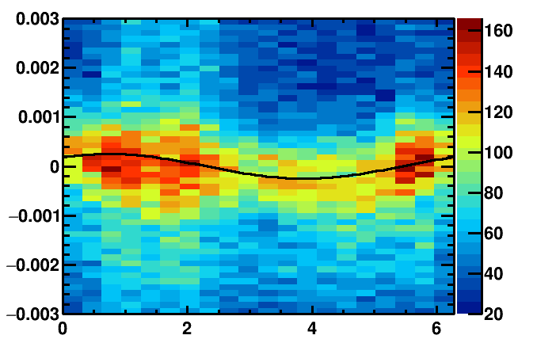
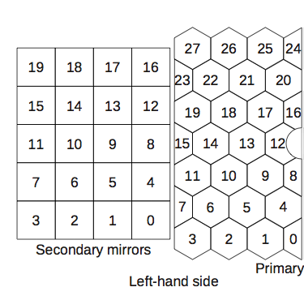
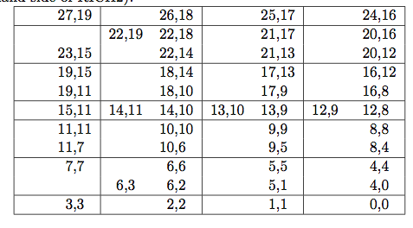
# of events for alignment
Running full alignment on data-samples of different size takes too long.
Toy-ish study:
Histograms made using2.7M events
Generate new histograms “with fewer events” from
Fit new histograms and compare results
Mirror combinations chosen for study
Left side of RICH2 detector:
Left side of RICH2 mirror combinations:

Slide 4
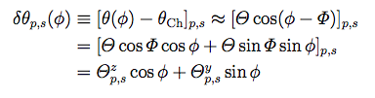
# of events for alignment
100 histograms ‘with 300k events’ generated + fitted (per mirror-pair)
Plot: fit-value – fit-value from entire dataset
2719
2214
Θ^{y} distribution
Θ^{z} distribution
Reference: 100 histograms with 2.7M events generated
1713
1208
2719
2214
Do for small and big tilts
Do for different ‘number of events’
1713
1208

Slide 5


Magnification coefficients
Translate fit-values into actual mirror-tilts
Could save A LOT of time if we didn’t calculate these every iteration!
Anatoly thinks they SHOULD be calculated,
Matt has (secretly) not calculated them for previous alignments.
How to quantify if necessary:
Redo alignment w/o calculating them (very small sample to verify effects)
For each iteration (of existing alignment) that we have calculate tilts using magnification coefficients obtained in first iteration
For existing alignments look at range of Mag^{α}/Mag^{β} => can the variation actually affect mirror tilts

Slide 6
To do
Unified Gaussian width in the dTheta vs phi fits? Same principle as above (compare results of fit with and without unified width)
Cherenkov angle resolution (ambiguous + unambiguous photons) in each iteration and give it to the Iterator.
Check for abnormal tilts/ magnification coefficients.
Antonis’s idea: Calculate the magnification coefficients only for the first iteration…
Alarms and Monitoring
Anything else?

